Slide 1
21CSS201T COMPUTER ORGANIZATION AND ARCHITECTURE UNIT-2 Topic : Addressing Modes and Case Study: 8086

Slide 2
Addressing Modes

Slide 3
Addressing Modes
Different ways in which the location of the operand is specified in an instruction is referred as addressing modes. The purpose of using addressing mode is:
To give the programming versatility to the user.
To reduce the number of bits in addressing field of instruction.
Types of Addressing Modes
Immediate Addressing
Direct Addressing
Indirect Addressing
Register Addressing
Register Indirect Addressing
Relative Addressing
Indexed Addressing
Auto Increment
Auto Decrement

Slide 4
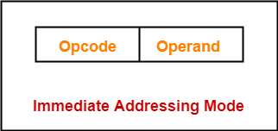
Immediate Addressing
Operand is given explicitly in the instruction
e.g. ADD 5
Add 5 to contents of accumulator
5 is operand
No memory reference to fetch data
Fast
Limited range
MOV AL,25H ; Immediate addressing AL=25
MOV AX,2345H ; AX=2345 AX=> AH=23 AL=45

Slide 5
Direct Addressing
Address field contains address of operand
Effective address (EA) = address field (A)
e.g. ADD A
Add contents of cell A to accumulator
Look in memory at address A for operand
Single memory reference to access data
No additional calculations to work out effective address
Limited address space
MOV AL,DATA1 ; Direct Addressing AL=23
MOV AX,DATA2 ; AX=1234
MOV DATA3,AL ; DATA3=23
MOV DATA4,AX ; DATA4=1234

Slide 6
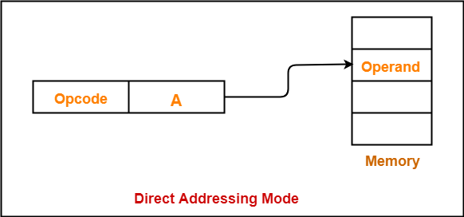

Slide 7
Indirect Addressing
Memory cell pointed to by address field contains the address of (pointer to) the operand
Two references to memory are required to fetch the operand.
Effective Address = [A]
Look in A, find address (A) and look there for operand
e.g. ADD (A)
Add contents of cell pointed to by contents of A to the accumulator
Notes:
7

Slide 8
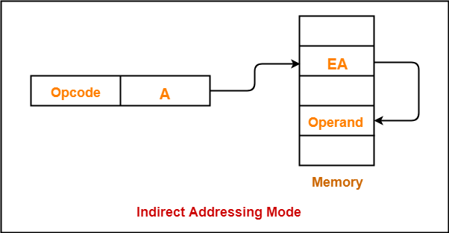

Slide 9
Register Direct Addressing
In this addressing mode,
The operand is contained in a register set.
The address field of the instruction refers to a CPU register that contains the operand.
No memory access
Very fast execution
Very limited address space
Limited number of registers
Very small address field needed
Shorter instructions
Faster instruction fetch
Notes:
10

Slide 10
Register Direct Addressing
Eg:
ADD R will increment the value stored in the accumulator by the content of register R.
AC ← AC + [R]
This addressing mode is similar to direct addressing mode.
The only difference is address field of the instruction refers to a CPU register instead of main memory.
Notes:
11

Slide 11
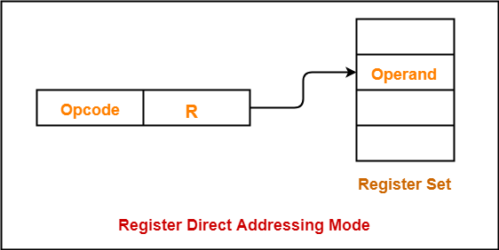

Slide 12
Register Indirect Addressing
The address field of the instruction refers to a CPU register that contains the effective address of the operand.
Only one reference to memory is required to fetch the operand
Eg:
ADD R will increment the value stored in the accumulator by the content of memory location specified in register R.
AC ← AC + [[R]]
Notes:
13

Slide 13
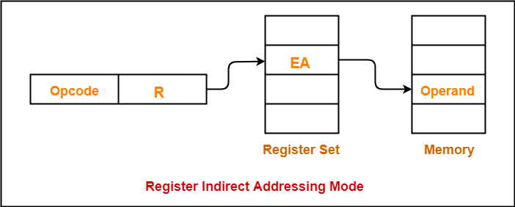

Slide 14
Indexed Addressing
In this addressing mode,
Effective address of the operand is obtained by adding the content of index register with the address part of the instruction.
Effective Address = Content of Index Register + Address part of the instruction
Notes:
15

Slide 15
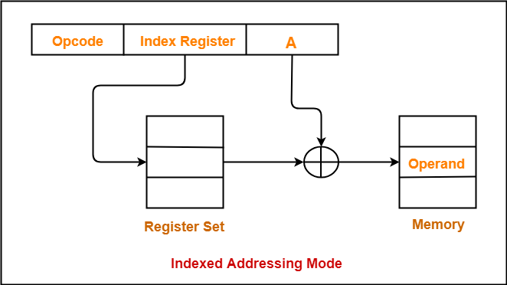

Slide 16
Relative Addressing
A version of displacement addressing
In this addressing mode,
Effective address of the operand is obtained by adding the content of program counter with the address part of the instruction.
Effective Address = Content of Program Counter + Address part of the instruction
Notes:
17

Slide 17
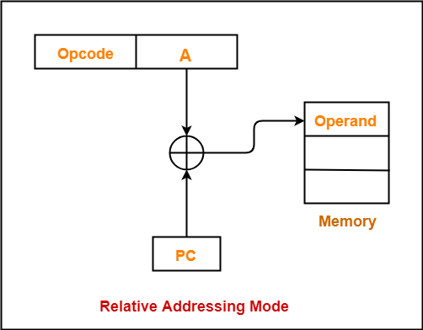

Slide 18
Auto Increment Mode
A special case of Register Indirect Addressing Mode where
Effective Address of the Operand = Content of Register
In this addressing mode,
After accessing the operand, the content of the register is automatically incremented by step size ‘d’.
Step size ‘d’ depends on the size of operand accessed.
Only one reference to memory is required to fetch the operand.

Slide 19
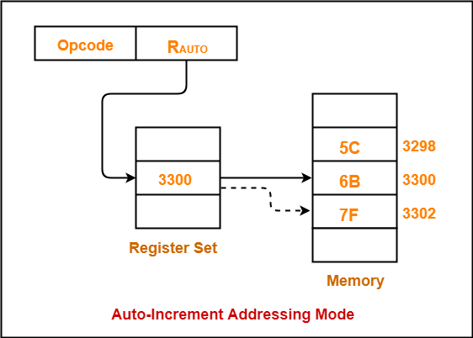

Slide 20
Auto Decrement Mode
A special case of Register Indirect Addressing Mode where
Effective Address of the Operand = Content of Register – Step Size
In this addressing mode
First, the content of the register is decremented by step size ‘d’.
Step size ‘d’ depends on the size of operand accessed.
After decrementing, the operand is read.
Only one reference to memory is required to fetch the operand.

Slide 21
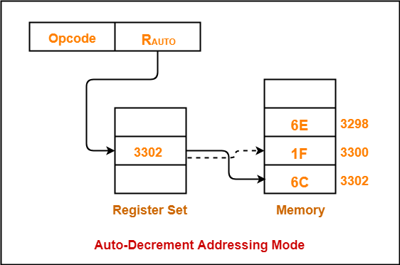

Slide 22
Case Study: 8086 Introduction to Microprocessor

Slide 23
Microprocessors
Microprocessor : is a CPU on a single chip.
Microcontroller: If a microprocessor, its associated support circuitry, memory and peripheral I/O components are implemented on a single chip, it is a microcontroller.
We use AVR microcontroller as the example in our course study

Slide 24
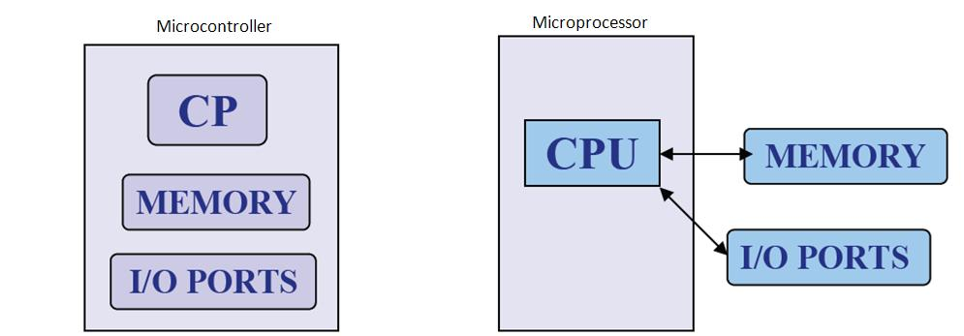
What is Microprocessor and Microcontroller?

Slide 25
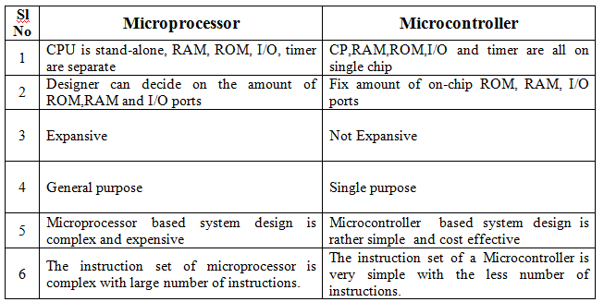

Slide 26
Internal structure and basic operation of microprocessor
ALU
Register Section
Address bus
Data bus
Control and timing section
Control bus
Block diagram of a Microprocessor

Slide 27
Microprocessor performs three main tasks:
data transfer between itself and the memory or I/O systems
simple arithmetic and logic operations
program flow via simple decisions

Slide 28
Microprocessor types
Microprocessors can be characterized based on
the word size
8 bit, 16 bit, 32 bit, etc. processors
Instruction set structure
RISC (Reduced Instruction Set Computer), CISC (Complex Instruction Set Computer)
Functions
General purpose, special purpose such image processing, floating point calculations
And more …

Slide 29
Evolution of Microprocessors
The first microprocessor was introduced in 1971 by Intel Corp.
It was named Intel 4004 as it was a 4 bit processor.
Categories according to the generations or size
First Generation (4 - bit Microprocessors)
could perform simple arithmetic such as addition, subtraction, and logical operations like Boolean OR and Boolean AND.
had a control unit capable of performing control functions like
fetching an instruction from storage memory,
decoding it, and then
generating control pulses to execute it.

Slide 30
Second Generation (8 - bit Microprocessor)
The second generation microprocessors were introduced in 1973 again by Intel.
the first 8 - bit microprocessor which could perform arithmetic and logic operations on 8-bit words.
Third Generation (16 - bit Microprocessor)
introduced in 1978
represented by Intel's 8086, Zilog Z800 and 80286,
16 - bit processors with a performance like minicomputers.

Slide 31
Fourth Generation (32 - bit Microprocessors)
Several different companies introduced the 32-bit microprocessors
the most popular one is the Intel 80386
Fifth Generation (64 - bit Microprocessors)
Introduced in 1995
After 80856, Intel came out with a new processor namely Pentium processor followed by Pentium Pro CPU
allows multiple CPUs in a single system to achieve multiprocessing.
Other improved 64-bit processors are Celeron, Dual, Quad, Octa Core processors.

Slide 32
Typical microprocessors
Most commonly used
68K
Motorola
x86
Intel
IA-64
Intel
MIPS
Microprocessor without interlocked pipeline stages
ARM
Advanced RISC Machine
PowerPC
Apple-IBM-Motorola alliance
Atmel AVR
A brief summary will be given later

Slide 33
8086 Microprocessor
designed by Intel in 1976
16-bit Microprocessor having
20 address lines
16 data lines
provides up to 1MB storage
consists of powerful instruction set, which provides operations like multiplication and division easily.
supports two modes of operation
Maximum mode : suitable for system having multiple processors
Minimum mode : suitable for system having a single processor.

Slide 34
Features of 8086
Has an instruction queue, which is capable of storing six instruction bytes
First 16-bit processor having
16-bit ALU
16-bit registers
internal data bus
16-bit external data bus
uses two stages of pipelining
1. Fetch Stage and
2. Execute Stage
which improves performance.
Fetch stage : can pre-fetch up to 6 bytes of instructions and stores them in the queue.
Execute stage : executes these instructions.

Slide 35
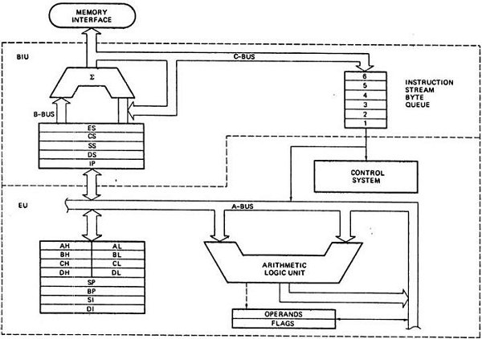
Architecture of 8086

Slide 36
Segments in 8086
memory is divided into various sections called segments
Code segment : where you store the program.
Data segment : where the data is stored.
Extra segment : mostly used for string operations.
Stack segment : used to push/pop

Slide 37
General purpose registers
used to store temporary data within the microprocessor
AX – Accumulator
16 bit register
divided into two 8-bit registers AH and AL
to perform 8-bit instructions also
generally used for arithmetical and logical instructions
BX – Base register
16 bit register
divided into two 8-bit registers BH and BL
to perform 8-bit instructions also
Used to store the value of the offset.

Slide 38
CX – Counter register
16 bit register
divided into two 8-bit registers CH and CL
to perform 8-bit instructions also Used in looping and rotation
DX – Data register
16 bit register
divided into two 8-bit registers DH and DL to
perform 8-bit instructions also Used in multiplication an input/output port addressing

Slide 39
Pointers and Index Registers
SP – Stack pointer
16 bit register
points to the topmost item of the stack
If the stack is empty the stack pointer will be (FFFE)H
It’s offset address relative to stack segment
BP –Base pointer
16 bit register
used in accessing parameters passed by the stack
It’s offset address relative to stack segment

Slide 40
SI – Source index register
16 bit register
used in the pointer addressing of data and
as a source in some string related operations
It’s offset is relative to data segment
DI – Destination index register
16 bit register used in the pointer addressing of data and
as a destination in string related operations
It’s offset is relative to extra segment.

Slide 41
IP - Instruction Pointer
16 bit register
stores the address of the next instruction to be executed
also acts as an offset for CS register.

Slide 42
Segment Registers
CS - Code Segment Register: user cannot modify the content of these registers
Only the microprocessor's compiler can do this
DS - Data Segment Register: The user can modify the content of the data segment.
SS - Stack Segment Registers: used to store the information about the memory segment.
operations of the SS are mainly Push and Pop.
ES - Extra Segment Register: By default, the control of the compiler remains in the DS where the user can add and modify the instructions
If there is less space in that segment, then ES is used
Also used for copying purpose.

Slide 43
Flag or Status Register
16-bit register
contains 9 flags
remaining 7 bits are idle in this register
These flags tell about the status of the processor after any arithmetic or logical operation
IF the flag value is 1, the flag is set, and if it is 0, it is said to be reset.

Slide 44
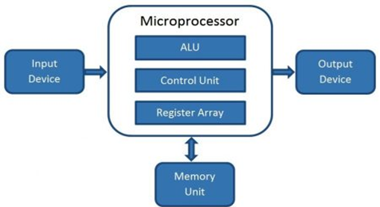
Microcomputer
Block Diagram
A digital computer with one microprocessor which acts as a CPU
A complete computer on a small scale, designed for use by one person at a time
called a personal computer (PC)
a device based on a single-chip microprocessor
includes laptops and desktops

Slide 45
Introduction to 8086 Assembly Language
Assembly Language Programming

Slide 46
Program Statements
Program consist of statement, one per line.
Each statement is either an instruction, which the assembler translate into machine code, or assembler directive, which instructs the assembler to perform some specific task, such as allocating memory space for a variable or creating a procedure.
Both instructions and directives have up to four fields:
At least one blank or tab character must separate the fields
name operation operand(s) comment

Slide 47
Program Statements
An example of an instruction is
START: MOV CX,5 ; initialize counter
The name field consists of the label START:
The operation is MOV, the operands are CX and 5
And the comment is ; initialize counter
name operation operand(s) comment
of An example an assembler directive is
MAIN PROC
MAIN is the name, and the operation field contains PROC
This particular directive creates a procedure called MAIN
name operation operand(s) comment

Slide 48
Program Statements
name operation operand(s) comment
A Name field identifies a label, variable, or symbol.
It may contain any of the following character : A,B…..Z ; a,b….9 ; ? ;
_ (underline) ; @ ; $ ; ,1e . (p….z ; 0riod)
Only the first 31 characters are recognized
There is no distinction between uppercase and lower case letters.
The first character may not be a digit
If it is used, the period ( . ) may be used only as the first character.
A programmer-chosen name may not be the same as an assembler reserved word.

Slide 49
Program Statements
name operation operand(s) comment
Operation field is a predefined or reserved word
mnemonic - symbolic operation code.
The assembler translates a symbolic opcode into a machine language opcode.
Opcode symbols often discribe the operation’s function; for example, MOV, ADD, SUB
assemler directive - pseudo-operation code.
In an assembler directive, the operation field contains a pseudo-operation code (pseudo-op)
Pseudo-op are not translated into machine code; for example the PROC pseudo-op is used to create a procedure

Slide 50
Program Statements
name operation operand(s) comment
An operand field specifies the data that are to be acted on by the operation.
An instruction may have zero, one, or two operands. For example:
NOP No operands; does nothing
INC AX one operand; adds 1 to the contents of AX
ADD WORD1,2 two operands; adds 2 to the contents of memory word WORD1

Slide 51
Program Statements
name operation operand(s) comment
The comment field is used by the programmer to say something about what the statement does.
A semicolon marks the beginning of this field, and the assembler ignores anything typed after semicolon.
Comments are optional, but because assembly language is low level, it is almost impossible to understand an assembly language program without comments.

Slide 52
Program Data and Storage
Pseudo-ops to define data or reserve storage
DB - byte(s)
DW - word(s)
DD - doubleword(s)
DQ - quadword(s)
DT - tenbyte(s)
These directives require one or more operands
define memory contents
specify amount of storage to reserve for run-time data

Slide 53
Defining Data
Numeric data values
100 - decimal
100B - binary
100H - hexadecimal
'100' - ASCII
"100" - ASCII
Use the appropriate DEFINE directive (byte, word, etc.)
A list of values may be used - the following creates 4 consecutive words
DW 40CH,10B,-13,0
A ? represents an uninitialized storage location
DB 255,?,-128,'X'

Slide 54
Naming Storage Locations
Names can be associated with storage locations
ANum DB -4
DW 17
ONE
UNO DW 1
X DD ?
These names are called variables
ANum refers to a byte storage location, initialized to FCh
The next word has no associated name
ONE and UNO refer to the same word
X is an unitialized doubleword

Slide 55
• Multiple definitions can b abbreviated
Example:e
message DB ’B’
DB ’y’
DB ’e’
DB 0DH
DB 0AH
can be written as
message DB ’B’,’y’,’e’,0DH,0AH
• More compactly as
message DB ’Bye’,0DH,0AH

Slide 56
Arrays
Any consecutive storage locations of the same size can be called an array
X DW 40CH,10B,-13,0
Y DB 'This is an array'
Z DD -109236, FFFFFFFFH, -1, 100B
Components of X are at X, X+2, X+4, X+6
Components of Y are at Y, Y+1, …, Y+15
Components of Z are at Z, Z+4, Z+8, Z+12

Slide 57
DUP
Allows a sequence of storage locations to be defined or reserved
Only used as an operand of a define directive
DB 40 DUP (?) ; 40 words, uninitialized
DW 10h DUP (0) ; 16 words, initialized as 0
Table1 DW 10 DUP (?) ; 10 words, uninitialized
message DB 3 DUP (’Baby’) ; 12 bytes, initialized
; as BabyBabyBaby
Name1 DB 30 DUP (’?’) ; 30 bytes, each
; initialized to ?

Slide 58
DUP
The DUP directive may also be nested
Example
stars DB 4 DUP(3 DUP (’*’),2 DUP (’?’),5 DUP (’!’))
Reserves 40-bytes space and initializes it as
***??!!!!!***??!!!!!***??!!!!!***??!!!!!
matrix DW 10 DUP (5 DUP (0))
defines a 10X5 matrix and initializes its elements to zero.
This declaration can also be done by
matrix DW 50 DUP (0)

Slide 59
Word Storage
Word, doubleword, and quadword data are stored in reverse byte order (in memory)
Directive Bytes in Storage
DW 256 00 01
DD 1234567H 67 45 23 01
DQ 10 0A 00 00 00 00 00 00 00
X DW 35DAh DA 35
Low byte of X is at X, high byte of X is at X+1

Slide 60
Word Storage

Slide 61
Named Constants
Symbolic names associated with storage locations represent addresses
Named constants are symbols created to represent specific values determined by an expression
Named constants can be numeric or string
Some named constants can be redefined
No storage is allocated for these values

Slide 62
Equal Sign Directive
name = expression
expression must be numeric
these symbols may be redefined at any time
maxint = 7FFFh
count = 1
DW count
count = count * 2
DW count

Slide 63
EQU Directive
name EQU expression
expression can be string or numeric
Use < and > to specify a string EQU
these symbols cannot be redefined later in the program
sample EQU 7Fh
aString EQU <1.234>
message EQU <This is a message>

Slide 64
Data Transfer Instructions
MOV target, source
reg, reg
mem, reg
reg, mem
mem, immed
reg, immed
Sizes of both operands must be the same
reg can be any non-segment register except IP cannot be the target register
MOV's between a segment register and memory or a 16-bit register are possible

Slide 65
Sample MOV Instructions
When a variable is created with a define directive, it is assigned a default size attribute (byte, word, etc)
You can assign a size attribute using LABEL
LoByte LABEL BYTE
aWord DW 97F2h
b db 4Fh
w dw 2048
mov bl,dh
mov ax,w
mov ch,b
mov al,255
mov w,-100
mov b,0

Slide 66
Program Segment Structure
Data Segments
Storage for variables
Variable addresses are computed as offsets from start of this segment
Code Segment
contains executable instructions
Stack Segment
used to set aside storage for the stack
Stack addresses are computed as offsets into this segment
Segment directives
.data
.code
.stack size

Slide 67
Instruction types Data transfer instructions
8086 instruction set
IN Input byte or word from port
LAHF Load AH from flags
LDS Load pointer using data segment
LEA Load effective address
LES Load pointer using extra segment
MOV Move to/from register/memory
OUT Output byte or word to port
POP Pop word off stack
POPF Pop flags off stack
PUSH Push word onto stack
PUSHF Push flags onto stack
SAHF Store AH into flags
XCHG Exchange byte or word
XLAT Translate byte
Additional 80386 instructions
LFS Load pointer using FS
LGS Load pointer using GS
LSS Load pointer using SS
MOVSX Move with sign extended
MOVZX Move with zero extended
POPAD Pop all double (32 bit) registers
POPD Pop double register
POPFD Pop double flag register
PUSHAD Push all double registers
PUSHD Push double register
PUSHFD Push double flag register
Additional 80286 instructions
INS Input string from port
OUTS Output string to port
POPA Pop all registers
PUSHA Push all registers
Additional 80486 instruction
BSWAP Byte swap
Additional Pentium instruction
MOV Move to/from control register

Slide 68
Arithmetic instructions
8086 instruction set
AAA ASCII adjust for addition
AAD ASCII adjust for division
AAM ASCII adjust for multiply
AAS ASCII adjust for subtraction
ADC Add byte or word plus carry
ADD Add byte or word
CBW Convert byte or word
CMP Compare byte or word
CWD Convert word to double-word
DAA Decimal adjust for addition
DAS Decimal adjust for subtraction
DEC Decrement byte or word by one
DIV Divide byte or word
IDIV Integer divide byte or word
IMUL Integer multiply byte or word
INC Increment byte or word by one
MUL Multiply byte or word (unsigned)
NEG Negate byte or word
SBB Subtract byte or word and carry (borrow)
SUB Subtract byte or word
Additional 80386 instructions
CDQ Convert double-word to quad-word
CWDE Convert word to double-word
Additional 80486 instructions
CMPXCHG Compare and exchange
XADD Exchange and add
Additional Pentium instruction
CMPXCHG8B Compare and exchange 8 bytes

Slide 69
Bit manipulation instructions
8086 instruction set
AND Logical AND of byte or word
NOT Logical NOT of byte or word
OR Logical OR of byte or word
RCL Rotate left trough carry byte or word
RCR Rotate right trough carry byte or word
ROL Rotate left byte or word
ROR Rotate right byte or word
SAL Arithmetic shift left byte or word
SAR Arithmetic shift right byte or word
SHL Logical shift left byte or word
SHR Logical shift right byte or word
TEST Test byte or word
XOR Logical exclusive-OR of byte or word
Additional 80386 instructions
BSF Bit scan forward
BSR Bit scan reverse
BT Bit test
BTC Bit test and complement
BTR Bit test and reset
BTS Bit test and set
SETcc Set byte on condition
SHLD Shift left double precision
SHRD Shift right double precision

Slide 70
String instructions
8086 instruction set
CMPS Compare byte or word string
LODS Load byte or word string
MOVS Move byte or word string
MOVSB(MOVSW) Move byte string (word string)
REP Repeat
REPE (REPZ) Repeat while equal (zero)
REPNE (REPNZ) Repeat while not equal (not zero)
SCAS Scan byte or word string
STOS Store byte or word string

Slide 71
Program Skeleton
.model small
.stack 100H
.data
;declarations
.code
main proc
;code
main endp
;other procs
end main
Select a memory model
Define the stack size
Declare variables
Write code
organize into procedures
Mark the end of the source file
optionally, define the entry point

Slide 72
EXAMPLE : Adding two 8 bit numbers
DATA SEGMENT ; Data Segment
N1DB 12H
N2 DB 21H
RES DB ?
DATA ENDS
CODE SEGMENT ; Code segment
ASSUME CS: CODE, DS: DATA
START: MOV AX, DATA
MOV DS, AX
MOV AL, N1
MOV BL, N2
ADD AL, BL
MOV RES, AL
INT 21H
CODE ENDS
END START

